Slide 1


Project Pre-Phase-2 Presentation
Green House Automated System for Sustainable Agriculture using IoT and Machine Learning
Team Members:
Srishreya - 4SF21IS109
Yogesh S Patgar - 4SF21IS125
P Samarth Shenoy - 4SF22IS406
Sujan Acharya - 4SF22IS410
Under the Guidance of:
Mrs. Masooda
Assistant Professor
ISE/ CSE(DS), SCEM
Department of Information Science and Engineering

Slide 2
Contents
Modular Diagram
ER Diagram
Problem Description
Objectives
Architecture Diagram
Class Diagram
Use Case Diagram
Sequence Diagram
Activity Diagram
Data Flow Diagram

Slide 3
Problem Description
Traditional greenhouse management involves significant manual labor and is due to human error, leading to suboptimal conditions for plant growth Key challenges include maintaining consistent temperature, humidity, light levels, and soil moisture, which are critical for plant health and yield.
Inefficient use of resources such as water and energy further exacerbates the problem. The lack of real-time monitoring and predictive capabilities often results in delayed responses to environmental changes, affecting crop production.

Slide 4
Objectives
Focused on state-of-the-art IoT-based greenhouse model such as monitoring, controlling, predicting
Identify the major challenges and gaps as well as present some future research direction to make IoT technology more robust in greenhouse farming
To develop machine learning models that can predict optimal conditions for plant growth and adjust the greenhouse environment accordingly
Provide a user-friendly interface for farmers to interact with the automated system

Slide 5
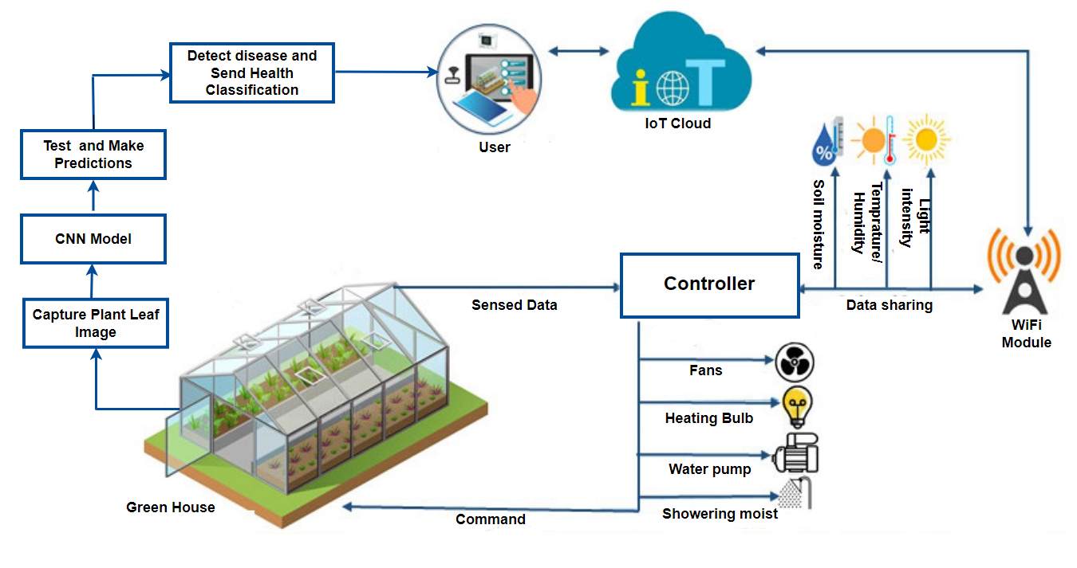
Architecture Diagram

Slide 6
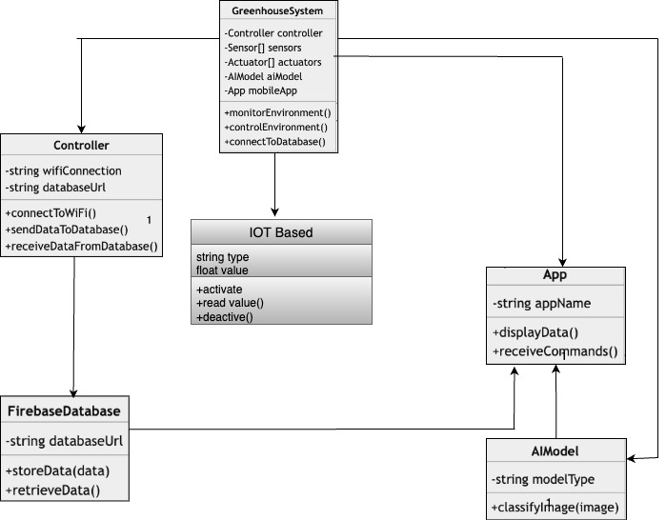
Class Diagram

Slide 7
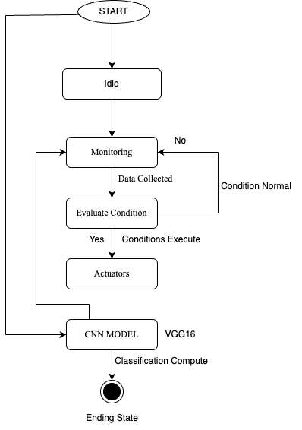
State Diagram

Slide 8
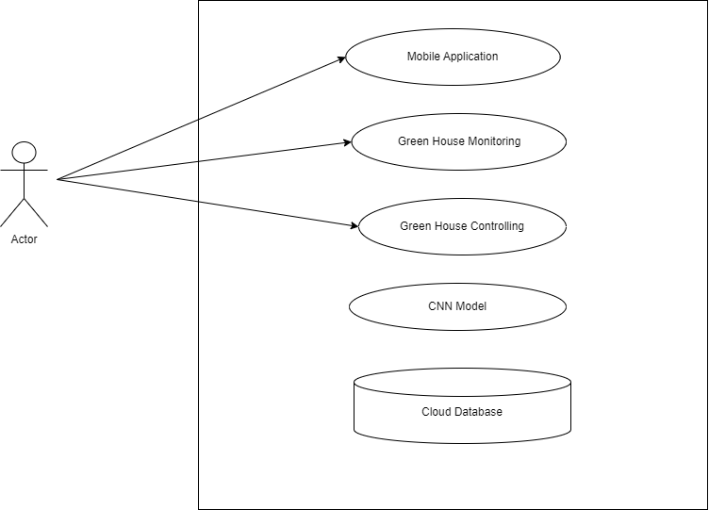
Use Case Diagram

Slide 9
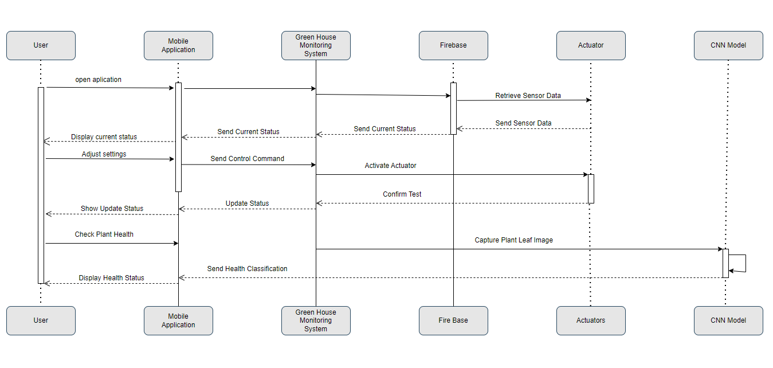
Sequence Diagram

Slide 10
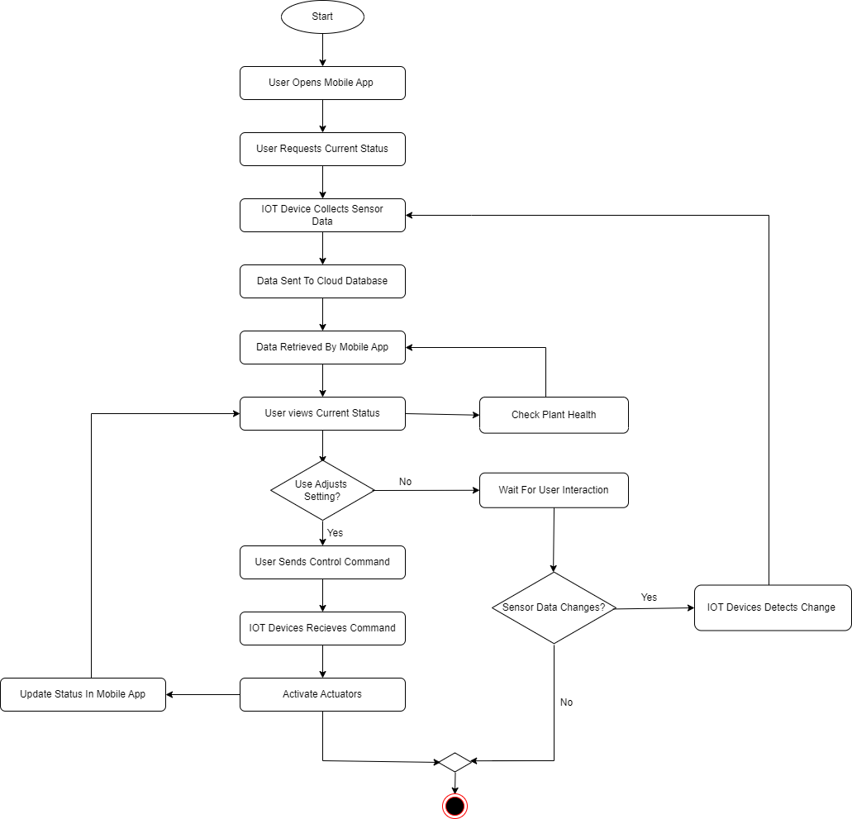
Activity Diagram

Slide 11
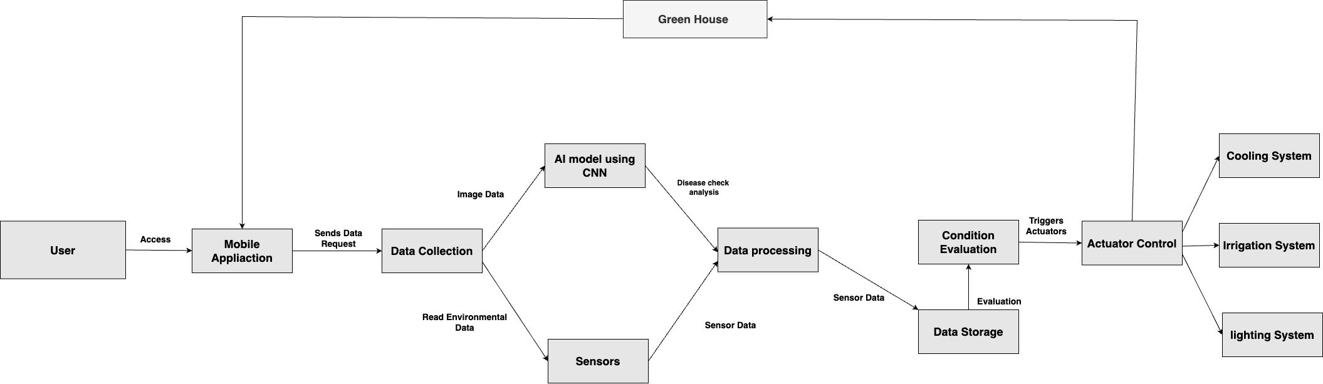
Data Flow Diagram

Slide 12
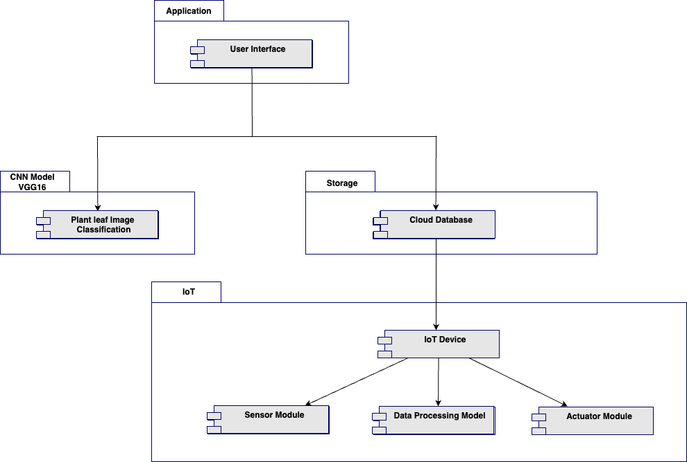
Modular Diagram

Slide 13
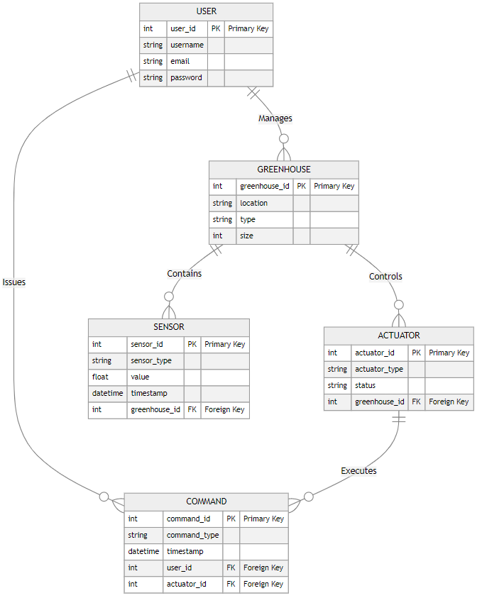
ER Diagram

Slide 14
Thank You

